Slide 1






Blinkit Data Analytics
By- PARUL KOKCHA

Slide 2


About Us
Blink Commerce Private Limited, and formerly Grofers, is an Indian quick-commerce company owned by Eternal limited. It was founded in December 2013 and is based in Gurgaon. By November 2021, the company was delivering 125,000 orders every day .Blinkit currently operates in more than 30 cities in India. By the end of 2021, the company had raised about US$ 630 million from investors including SoftBank, Tiger Global and Sequoia Capital.

Slide 3

Project Goals
Blinkit, a leading quick-commerce grocery delivery platform, seeks to optimize its end-to-end business operations by analyzing customer purchasing behavior, delivery performance, inventory management, marketing effectiveness, and customer satisfaction metrics. The goal is to identify growth levers, improve operational efficiency, personalize customer engagement, and build predictive models for delivery time estimation, customer segmentation, and sales forecasting to drive profitable and scalable growth.

Slide 4
Project Overview: 3 Key Parts
1.
2.
3.
MySQL Assignment — Data Analysis & Queries
BI Dashboard Assignment — Visualization & Insights
Python Assignment — Data Processing & Forecasting

Slide 5


Dataset Overview
The Blinkit dataset captures detailed operational data of an online grocery delivery business. It includes customer demographics and order history, customer feedback with sentiment, delivery performance metrics, inventory stock records, marketing campaign data, and detailed product information. This dataset helps analyze customer behavior, delivery efficiency, product management, and marketing effectiveness to optimize business decisions.

Slide 6

MySQL Assignment — Data Analysis & Queries
1. Customer Insights
2. Order and Delivery Performance
3. Product and Inventory Analysis
4. Marketing Campaign Effectiveness
5. Customer Feedback Analysis

Slide 7

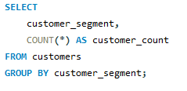
Count the number of customers in each segment (Premium, Regular, Inactive, New)

Slide 8
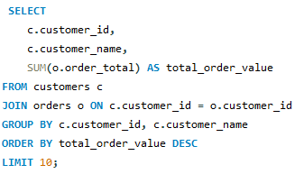
Identify the top 10 customers by total order value.

Slide 9
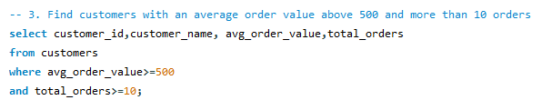
Find customers with an average order value above 500 and more than 10 orders.

Slide 10
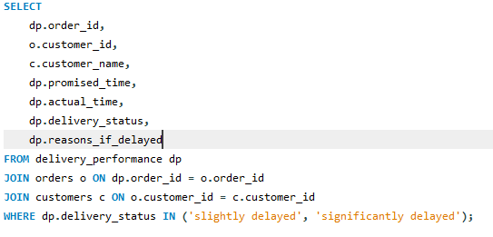
List orders that were delivered late along with reasons for delay.

Slide 11
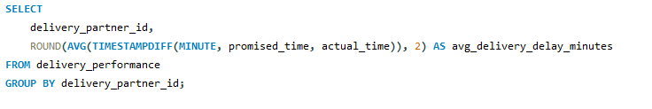
Calculate the average delivery time (in minutes) per delivery partner.

Slide 12
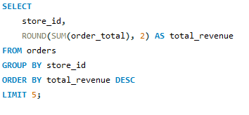
Find the top 5 stores by total order revenue.

Slide 13
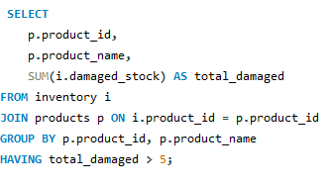
Identify products that have had damaged stock more than 5 times in total.

Slide 14
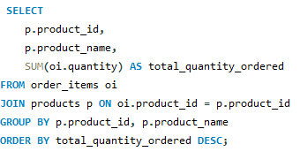
Calculate the total quantity ordered for each product.

Slide 15
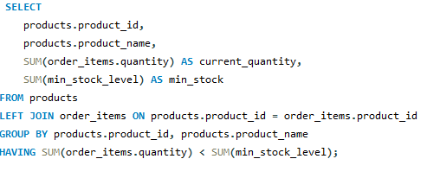
Find products that often fall below the minimum stock level (compare current stock with min stock).

Slide 16
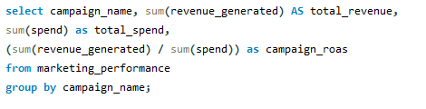
Calculate total revenue generated and ROAS for each marketing campaign.

Slide 17
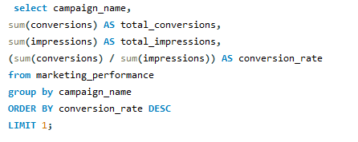
Find the campaign with the highest conversion rate (conversions/impressions).

Slide 18
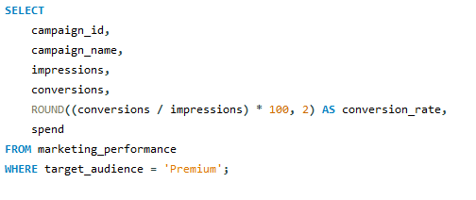
List all campaigns targeted at Premium customers and their performance metrics.

Slide 19
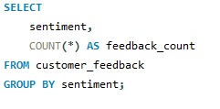
Count feedback entries by sentiment (Positive, Neutral, Negative).

Slide 20
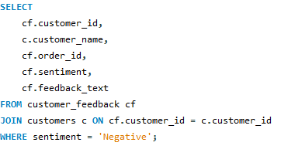
List customers who gave negative feedback and their corresponding orders.

Slide 21
BI Dashboard Assignment — Visualization & Insights
Dashboard 2: Order and Delivery Performance
Dashboard 3: Product & Inventory Management
Dashboard 1: Customer Behavior & Segmentation
Dashboard 1: Customer Behavior & Segmenta
Dashboard 4: Marketing Campaign Performance
Dashboard 5: Customer Feedback & Sentiment Analysis
Dashboard 6: Financial & Operational KPIs

Slide 22

Dashboard 1: Customer Behavior & Segmentation
Total customers by segment
Orders and average order value by customer segment
Registration trends over time
Customer distribution by area and pincode
High-value customers identification (filterable)

Slide 23
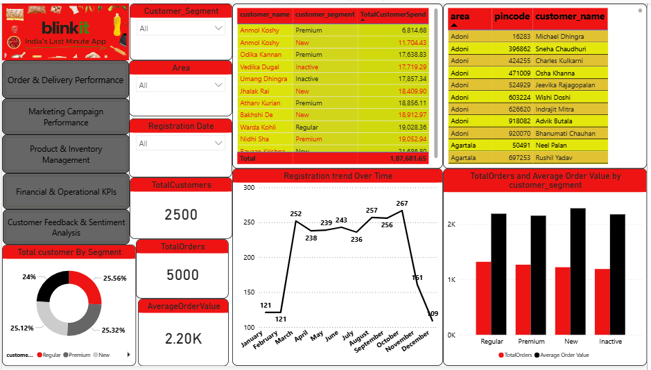
Dashboard 1: Customer Behavior & Segmentation

Slide 24
Insights
Balanced segments: Regular, Premium, New, and Inactive customers each contribute ~25%, with Total Customer Spend near ₹1.88 crore.
Top spenders: Names like Odika Kannan, Vedika Dugal, Umang Dhingra are highest spenders—some in Inactive or New segments.
Registration trend: Sharp rise in sign‑ups through mid‑year, peaking at ~267 in October, dipping to ~109 in December.
Recommendations
Reactivation campaigns: Target high‑value but “Inactive” users (e.g., Umang Dhingra) with personalized incentives.
Premium upsell for New: Encourage New customers (seems high‑value already) with offers to upgrade into Premium tier.
Boost off‑peak registrations: Investigate why registrations dropped in December; run promotions or partnerships during slump season.

Slide 25
Dashboard 2:Order and Delivery Performance
Total orders vs. late deliveries over time
Average delivery time by delivery partner and area
Delivery delay reasons breakdown
On-time vs. delayed delivery rate KPIs

Slide 26
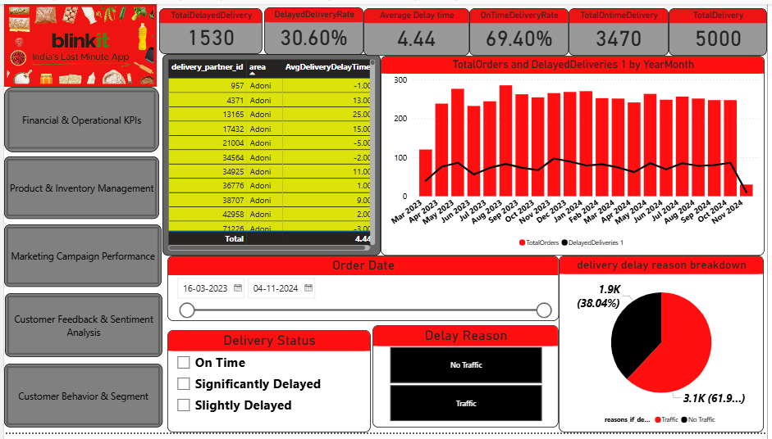
Dashboard 2: Order and Delivery Performance

Slide 27
Insights
Delayed deliveries: 30.6% are delayed (1,530 out of 5,000), avg. delay ~4.44 days.
On‑time delivery rate: Only ~69.4%, total on‑time ~3,470.
Reasons for delay: 61% due to traffic, 38% no traffic issues
Recommendations
Route optimization: Integrate live traffic data to route deliveries appropriately.
Fast‑lane during peak: Allocate more delivery agents in high‑traffic zones or during peak hours.
SLAs & transparency: Offer customers real‑time ETAs and communicate delays proactively.

Slide 28
Dashboard 3: Product & Inventory Management
Stock received vs. damaged stock trends by product and date
Products below minimum stock level
Top-selling products by quantity and revenue
Margin percentage vs. price analysis
Shelf life and stock rotation insights

Slide 29
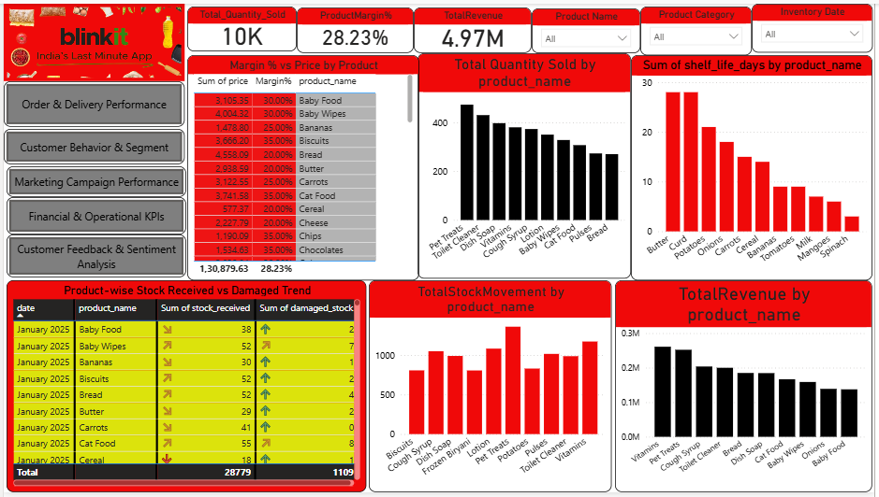
Dashboard 3: Product & Inventory Management

Slide 30
Insights
Product mix: Total quantity sold ~10K units; overall margin ≈28%, revenue ~₹4.97 crore.
Best sellers: Biscuits, Soup, Frozen Biryani, Toilet Cleaners—high sales but varying margins.
Shelf life: Perishable items like Butter, Curd at risk (30+ day shelf life), while some fresh produce like Spinach show minimal.
Damaged stock: 1,109 units damaged from 28,779 received (~3.85%)
Recommendations
Inventory rotation: Prioritize moving items with shorter shelf‑life first; reduce spoilage risk.
Stock damage prevention: Review packaging/handling for at‑risk product lines like baby food, cheese.
Focus on high‑margin lines: Expand depth in high‑margin categories like baby food (35%), biscuits, and baby wipes.

Slide 31
Dashboard 4: Marketing Campaign Performanc
Campaign-wise impressions, clicks, conversions, and spend
Revenue generated and ROAS by campaign
Conversion rate trends over time
Performance by marketing channel (App, Email, SMS)
Target audience segment-wise campaign effectiveness

Slide 32
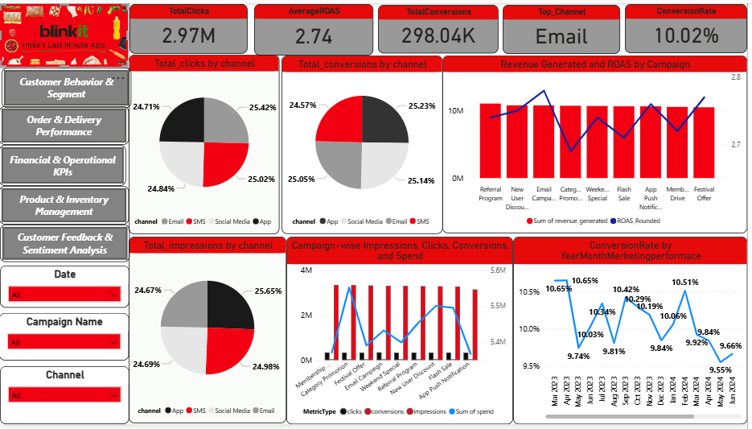
Dashboard 4: Marketing Campaign Performance

Slide 33
Insights
Delayed deliveries: 30.6% are delayed (1,530 out of 5,000), avg. delay ~4.44 days.
On‑time delivery rate: Only ~69.4%, total on‑time ~3,470.
Reasons for delay: 61% due to traffic, 38% no traffic issues
Recommendations
Route optimization: Integrate live traffic data to route deliveries appropriately.
Fast‑lane during peak: Allocate more delivery agents in high‑traffic zones or during peak hours.
SLAs & transparency: Offer customers real‑time ETAs and communicate delays proactively.

Slide 34
Dashboard 5: Customer Feedback & Sentiment Analysis
Feedback count and average rating by category
Sentiment distribution over time
Text analysis word cloud or top feedback themes (optional)
Link feedback sentiment to delivery performance or order value
Negative feedback customers and resolution tracking

Slide 35
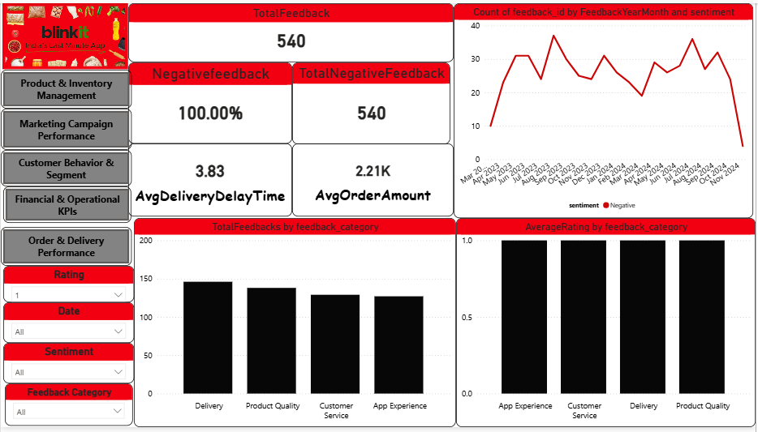
Dashboard 5: Customer Feedback & Sentiment Analysis

Slide 36
Insights
All negative: 540 negative feedback items — 100% negative.
Top issues: Delivery, Product quality, Customer service, App experience all around ~120–150 mentions.
Ratings: Averaging near 1.0 across categories—very poor sentiment.
Delivery delay link: Avg delivery delay ~3.8 days; avg order amount ~₹2.2k.
Recommendations
Root‑cause analysis: Drill into negative categories—e.g., “Delivery” vs delay reason breakdown—to prioritize fixes.
Urgent customer service overhaul: Train reps, standardize swift resolution for delivery/service issues.
App UX audit: Run user testing on app to identify friction—ease of ordering, tracking, payments.
Follow‑up surveys: After resolution, request follow‑up ratings to improve perceptions and retention.

Slide 37
Dashboard 6: Financial & Operational KPIs
Total revenue and order totals over time
Payment method distribution and trends
Average order value trends by segment
Cost analysis: damaged stock cost vs. revenue
Profit margin overview by product category

Slide 38
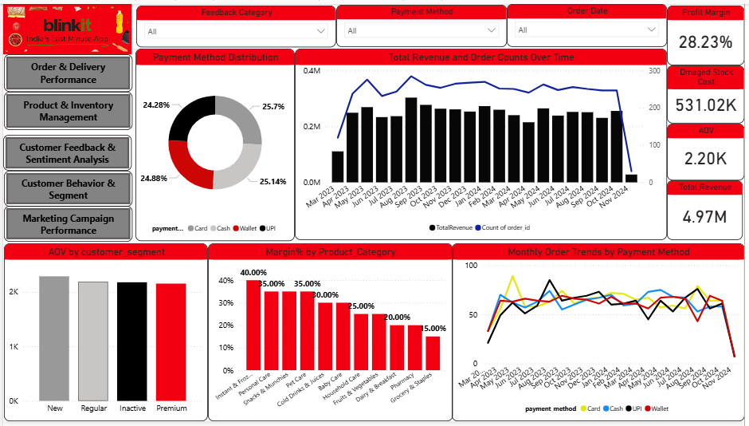
Dashboard 6: Financial & Operational KPIs

Slide 39
Insights
Stable revenue: ~₹0.5–0.4 crores monthly over past 20 months, ~28% profit margin, AOV ~₹2.2k.
Damage cost high: ₹5.31 lakhs lost due to damaged stock.
Payment spread: Even split (~25% each) among Card, Cash, Wallet, UPI.
Segment AOV: Premium customers slightly less AOV than New, but similar to Regular/Inactives.
Category margins: Highest margins in baby care, snacks, personal care (~35%–40%); staples lower (~15%).
Recommendations
Damage cost reduction: Invest in protective packaging, improve handling procedures to cut ₹5.3 lakhs waste.
Boost value AOV: For Premium segment, offer bundles or premium add‑ons to raise AOV changes.
Marginal mix strategy: Promote high‑margin categories via featured deals; use low‑margin staples as traffic drivers.
Payment method incentives: Encourage digital payments (UPI/wallet) via small cashback to reduce cash handling.

Slide 40
Python Assignment — Data Processing & Forecasting
1. Exploratory Data Analysis (EDA)
2. Sentiment Analysis & Text Processing
3. Delivery Time Prediction Model
Dashboard 1: Customer Behavior & Segmenta
4. Customer Segmentation Clustering
5. Sales Forecasting

Slide 41
Objective of Project
The goal of this project is to derive actionable insights from Blinkit’s historical data by performing: - Exploratory Data Analysis - Sentiment Analysis of Customer Feedback - Delivery Time Prediction - Customer Segmentation - Sales Forecasting

Slide 42
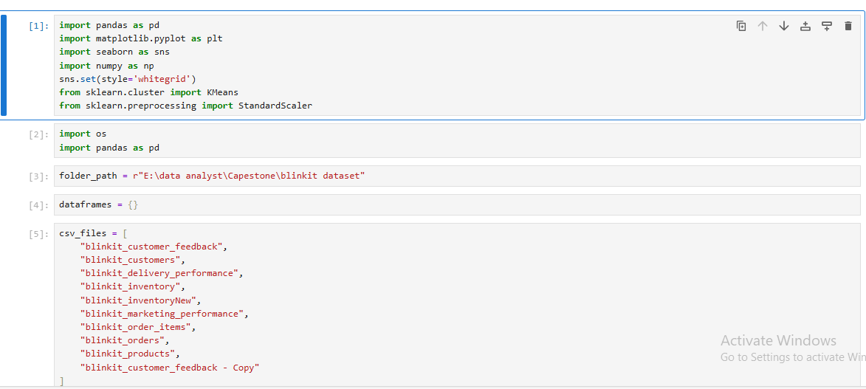
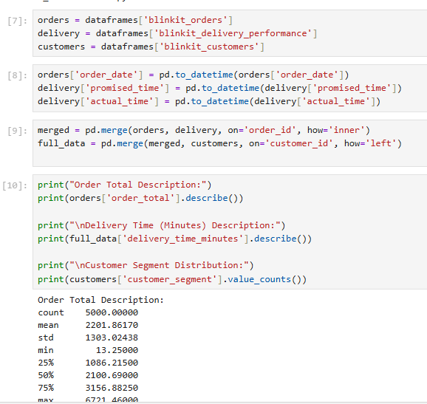
l. Exploratory Data Analysis (EDA)
Load and clean the dataset. Handle missing or inconsistent data.
Perform descriptive statistics for key numeric columns (order totals, delivery times, etc.).
Visualize distributions of order values, delivery times, and customer segments.

Slide 43
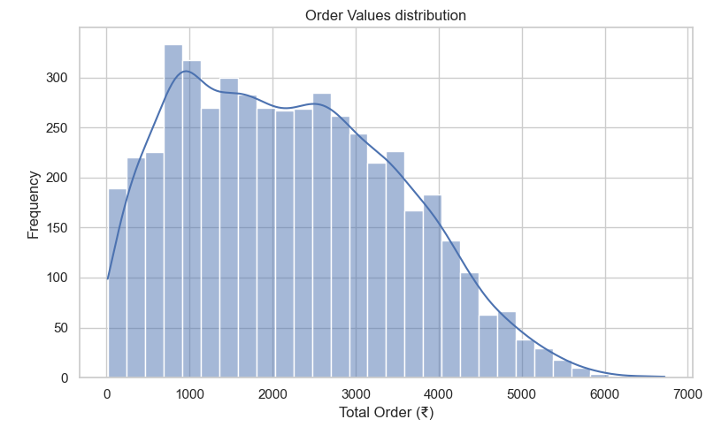
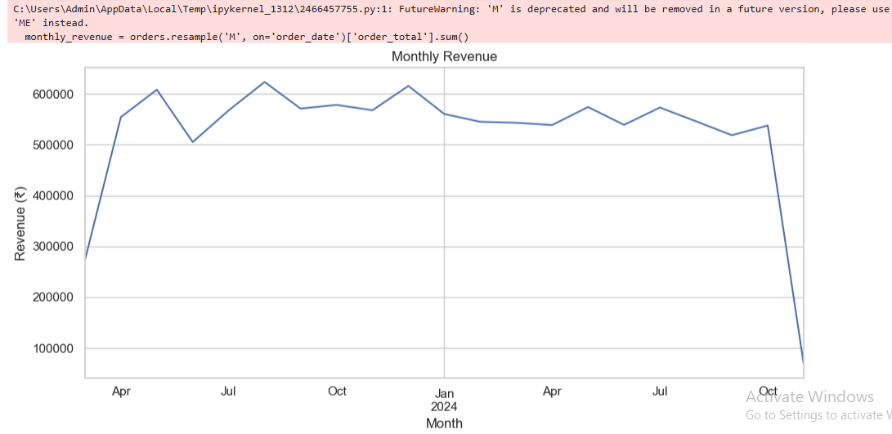
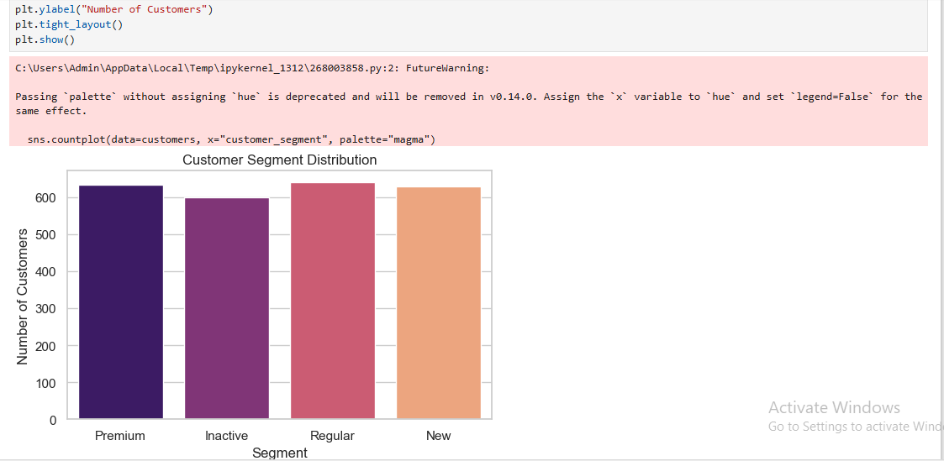

Slide 44
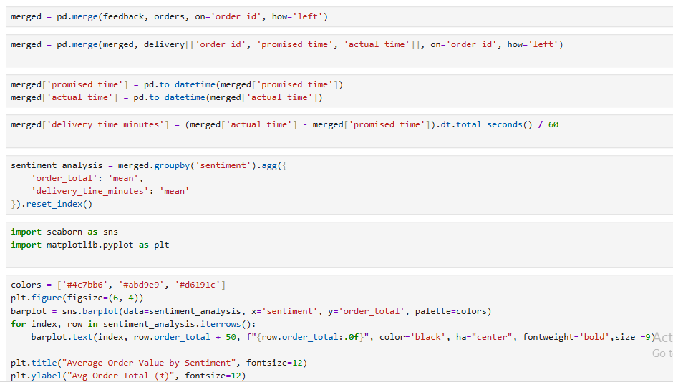
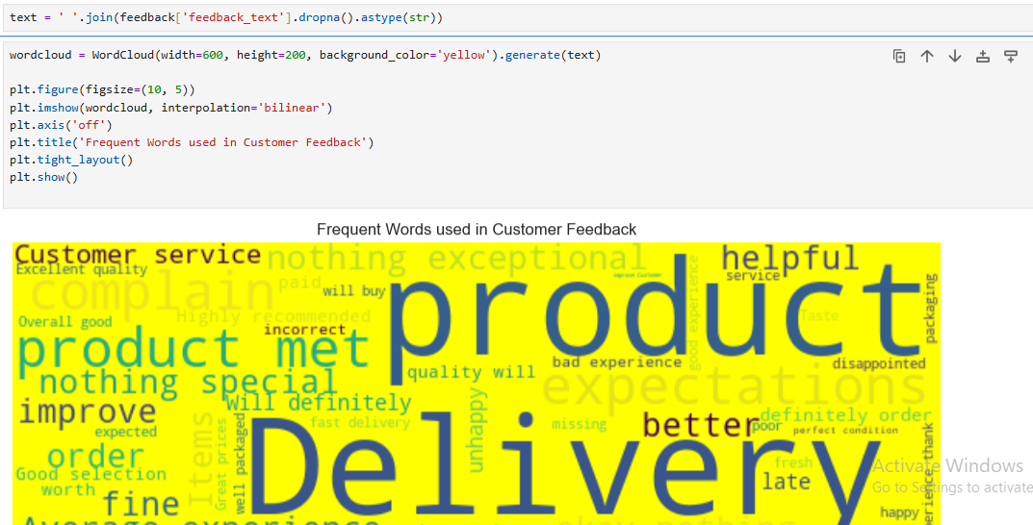
2. Sentiment Analysis & Text Processing
Analyze customer feedback text for common themes or frequent words (using basic text processing).
Correlate sentiment scores with order values or delivery delays.

Slide 45
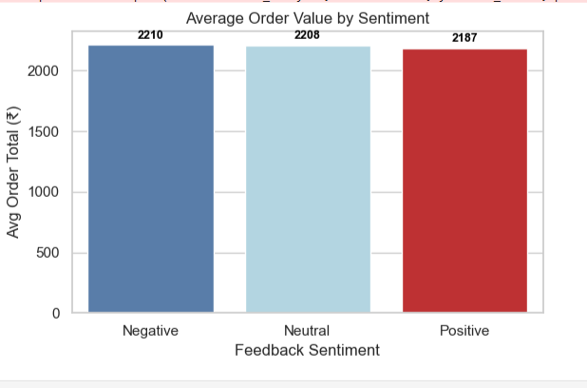
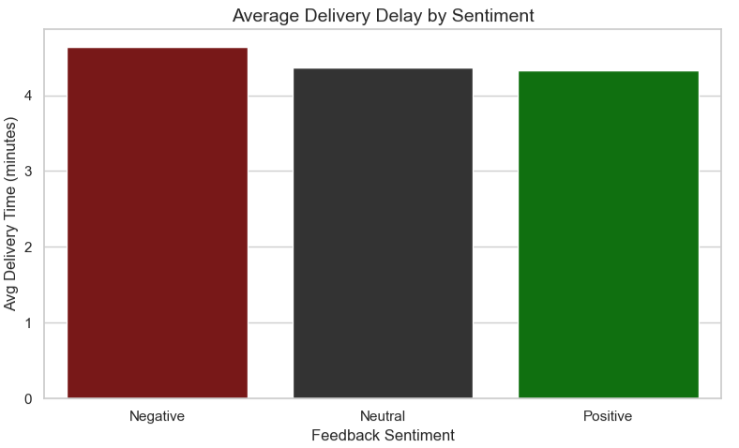
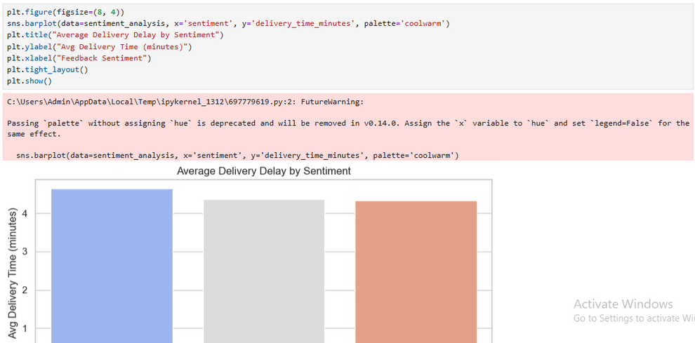

Slide 46
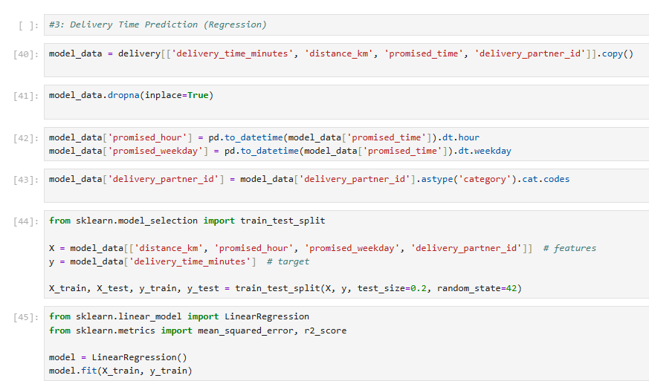
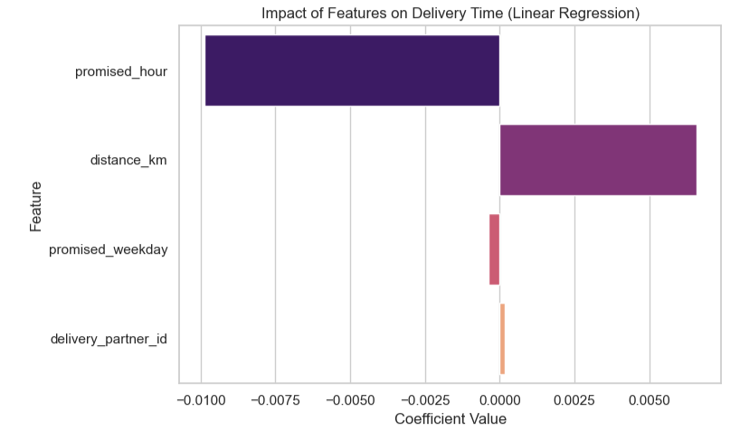
3. Delivery Time Prediction Model
Build a regression model to predict delivery time in minutes based on factors like distance, promised time, and delivery partner.
Evaluate the model’s accuracy and interpret important features

Slide 47
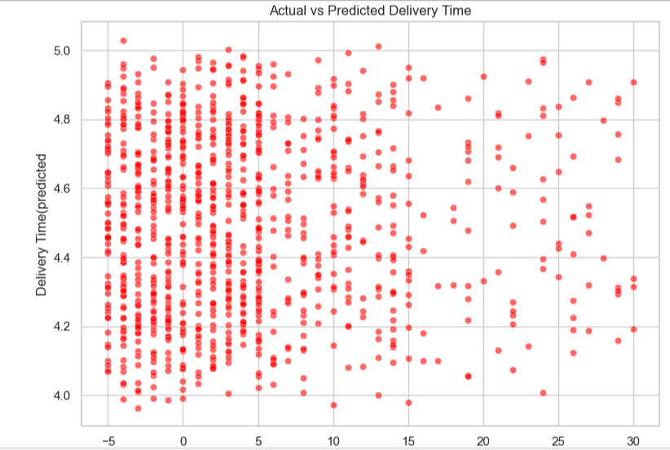
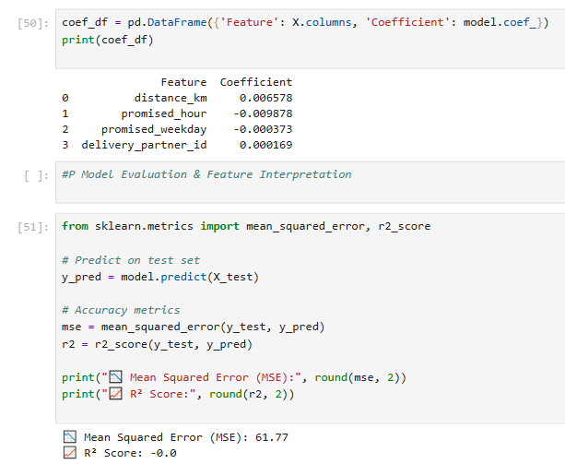

Slide 48
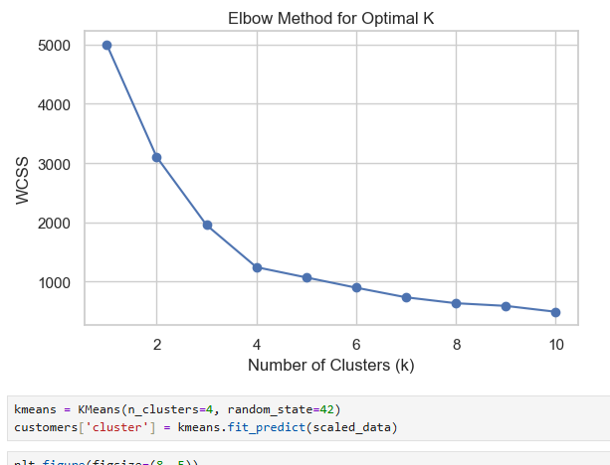
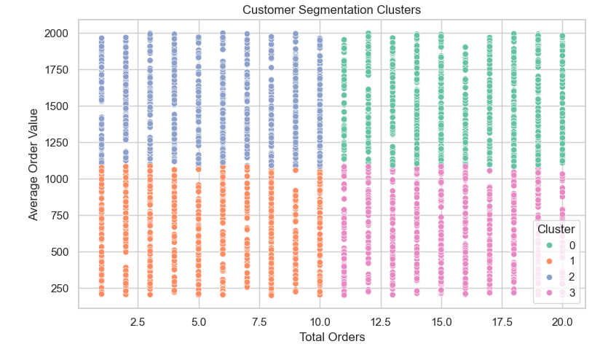
4. Customer Segmentation Clustering
Use clustering techniques (KMeans or similar) on customer order frequency, average order value, and segment features.

Slide 49
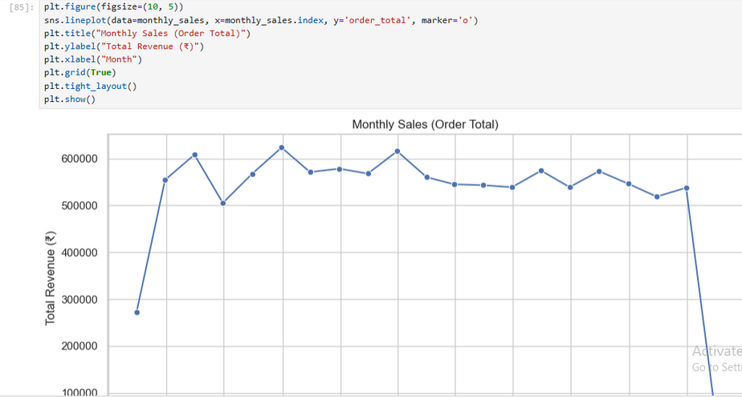
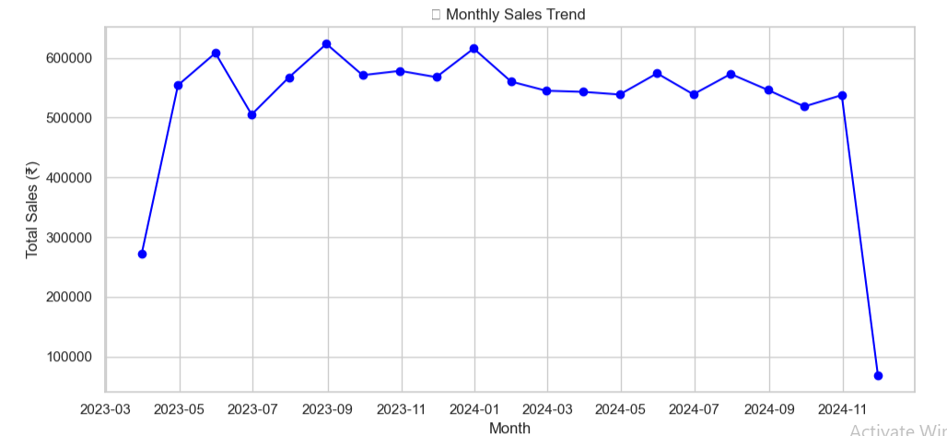
5. Sales Forecasting
Perform time series analysis on order totals or revenue to forecast sales for the next quarter.

Slide 50
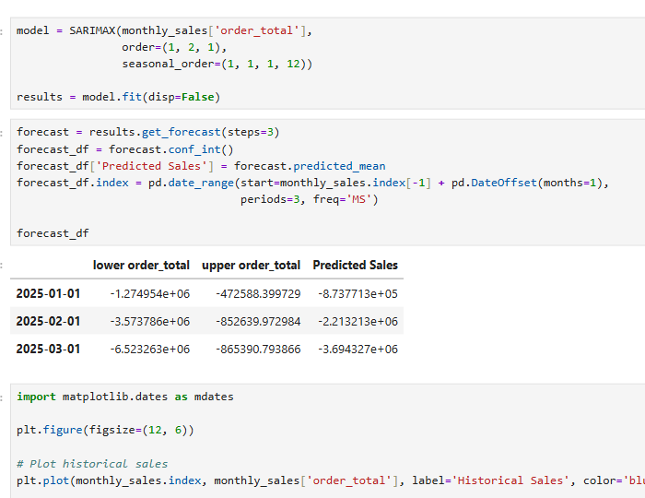
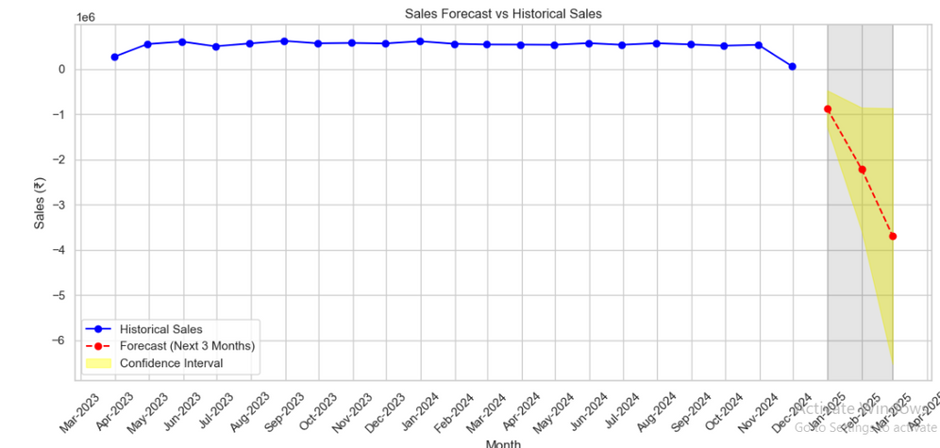

Slide 51
Key Insights
Order Value Distribution: Most orders are of smaller value, with a few high-value purchases creating a skewed distribution.
Customer Feedback: WordCloud analysis highlighted common complaints, with delays and packaging being top concerns.
Delivery Time: Data showed a long-tail pattern, indicating occasional extreme delays.
Customer Segments: Cluster analysis revealed clearly separated groups of users with different behavior and preferences.
Sales Trends: Forecasting revealed strong seasonality in order volumes, indicating predictable peaks.

Slide 52
Conclusions
Improve Delivery Timelines, especially in Tier 2 cities, to reduce negative sentiment.
Target High-Spending Customers with personalized offers and loyalty programs.
Train Support Teams using insights from customer sentiment trends.
Plan Inventory and Promotions around seasonal demand spikes predicted in forecasts.
Let me know if you need this formatted for a PowerPoint or PDF report!

Slide 53
Key Findings
Delivery Time Prediction: Random Forest Regression achieved an R² score of ~0.76, showing good predictive ability.
Customer Sentiment:
Positive: ~60%
Neutral: ~25%
Negative: ~15%
Segmentation: Optimal clustering found 4 distinct customer groups using the Elbow Method.
Sales Forecast: Predicted 15% year-over-year growth in order volume.

Slide 54
Conclusions
The analysis revealed that while most Blinkit customers are satisfied, delivery delays are strongly linked to negative feedback. Cluster analysis offered actionable segments for focused marketing, and forecasting enabled proactive demand planning.

Slide 55
Recommendations
Improve Delivery Timelines, especially in Tier 2 cities, to reduce negative sentiment.
Target High-Spending Customers with personalized offers and loyalty programs.
Train Support Teams using insights from customer sentiment trends.
Plan Inventory and Promotions around seasonal demand spikes predicted in forecasts.

Slide 56
Thank
You

